Slide 2
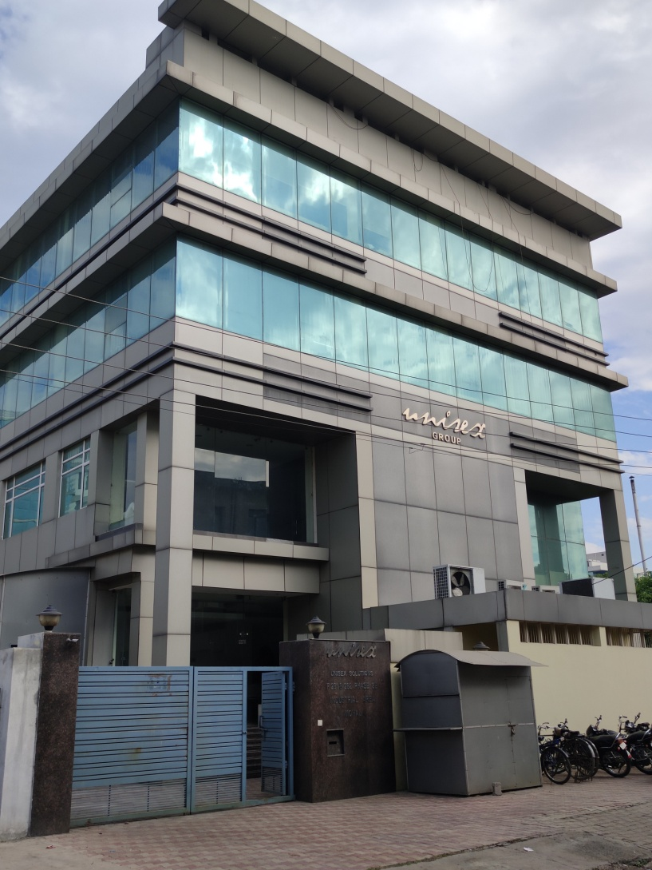
UNISEX SOLUTIONS
PHASE-8B,F-281-282,MOHALI

Slide 3
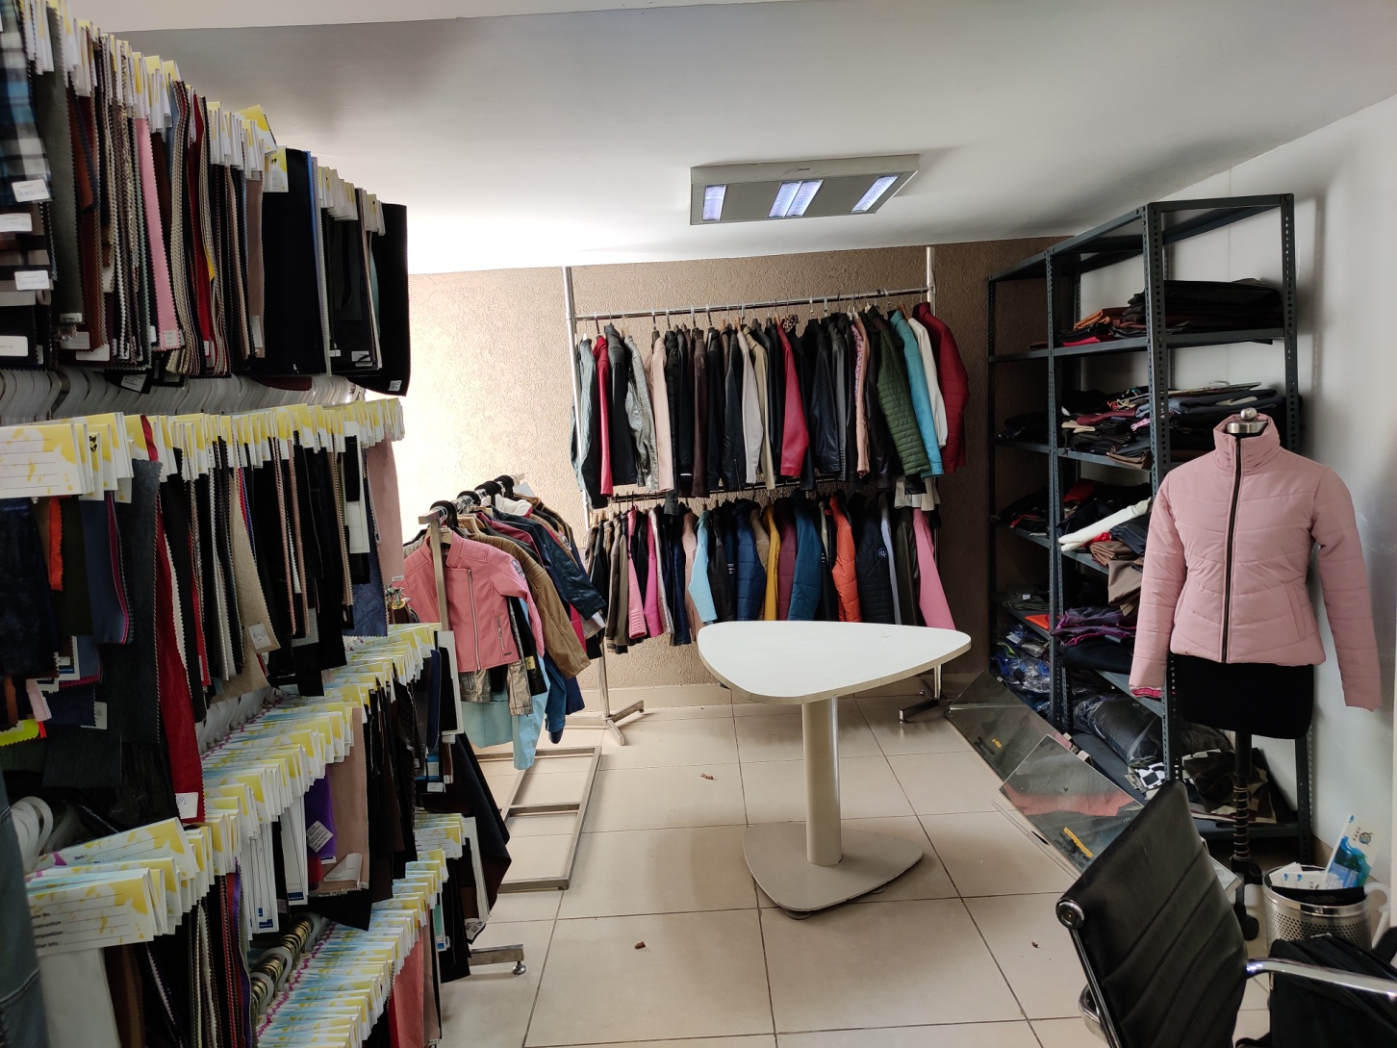
CONFERENCE ROOM IMAGE 1

Slide 4
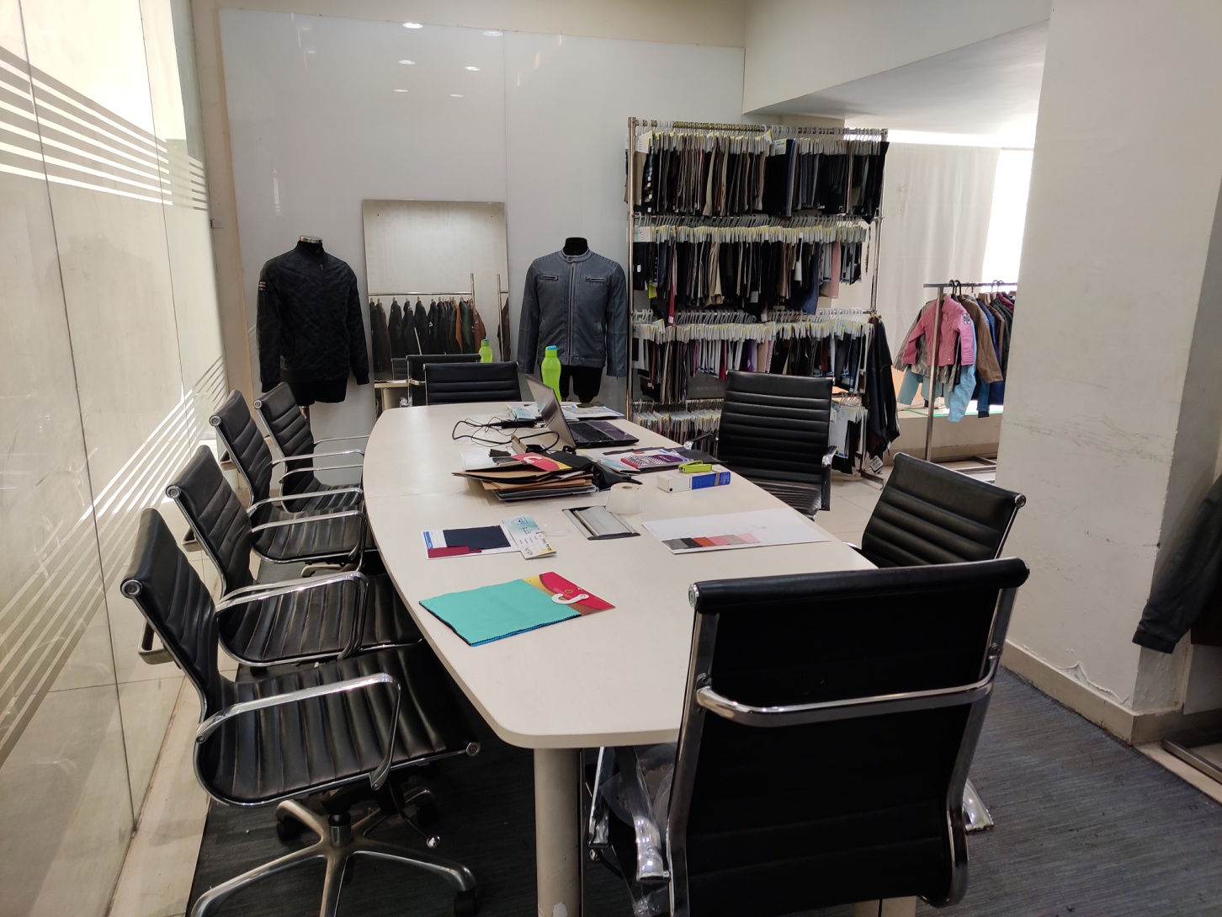
CONFERENCE ROOM IMAGE 2

Slide 5
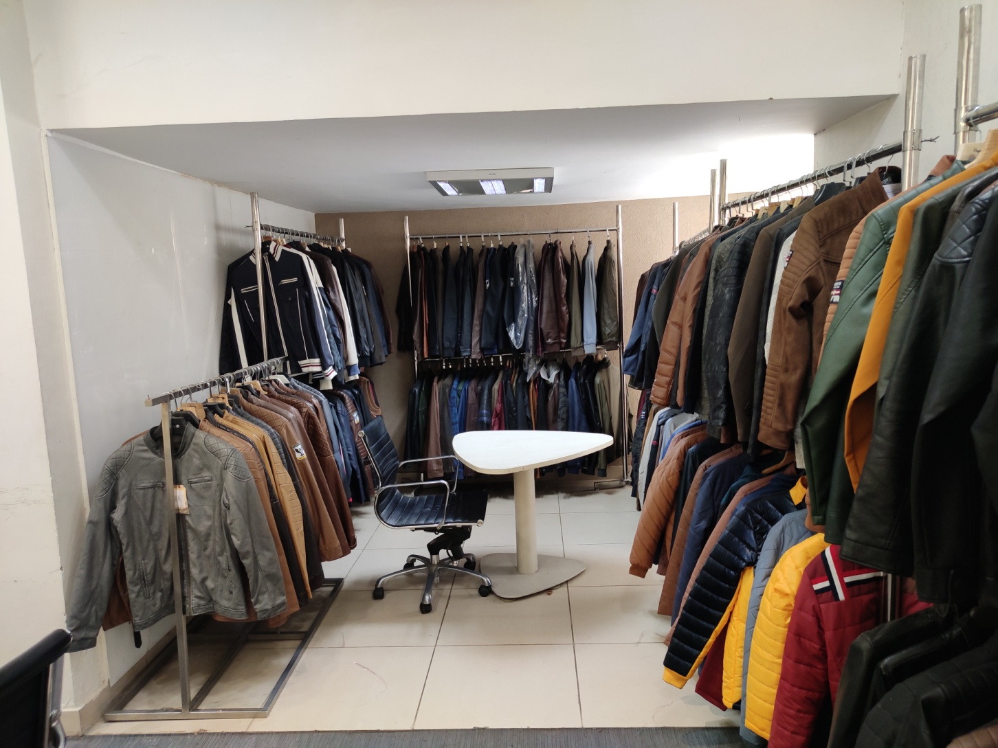
CONFERENCE ROOM IMAGE 3

Slide 6
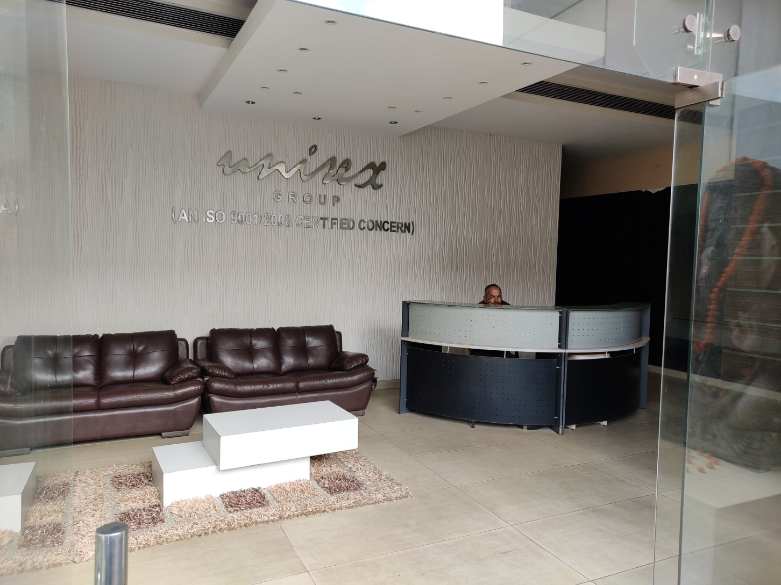
RECEPTION

Slide 7
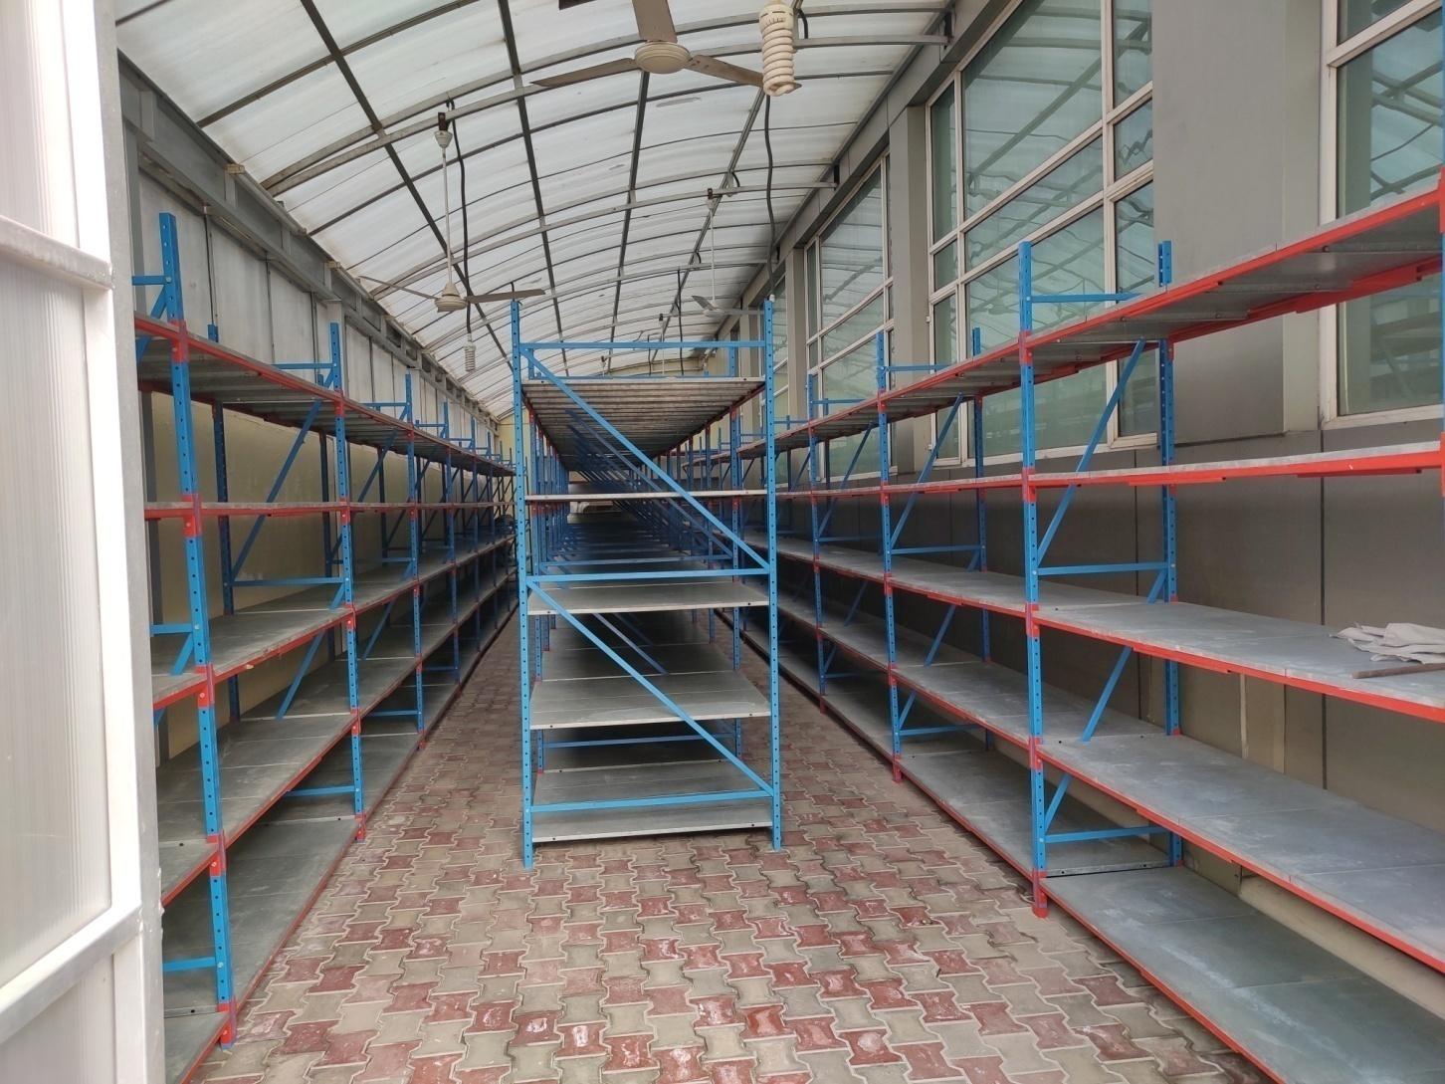
FABRIC STORE ON GROUND FLOOR WITH STORAGE CAPACITY 30000 MTR

Slide 8
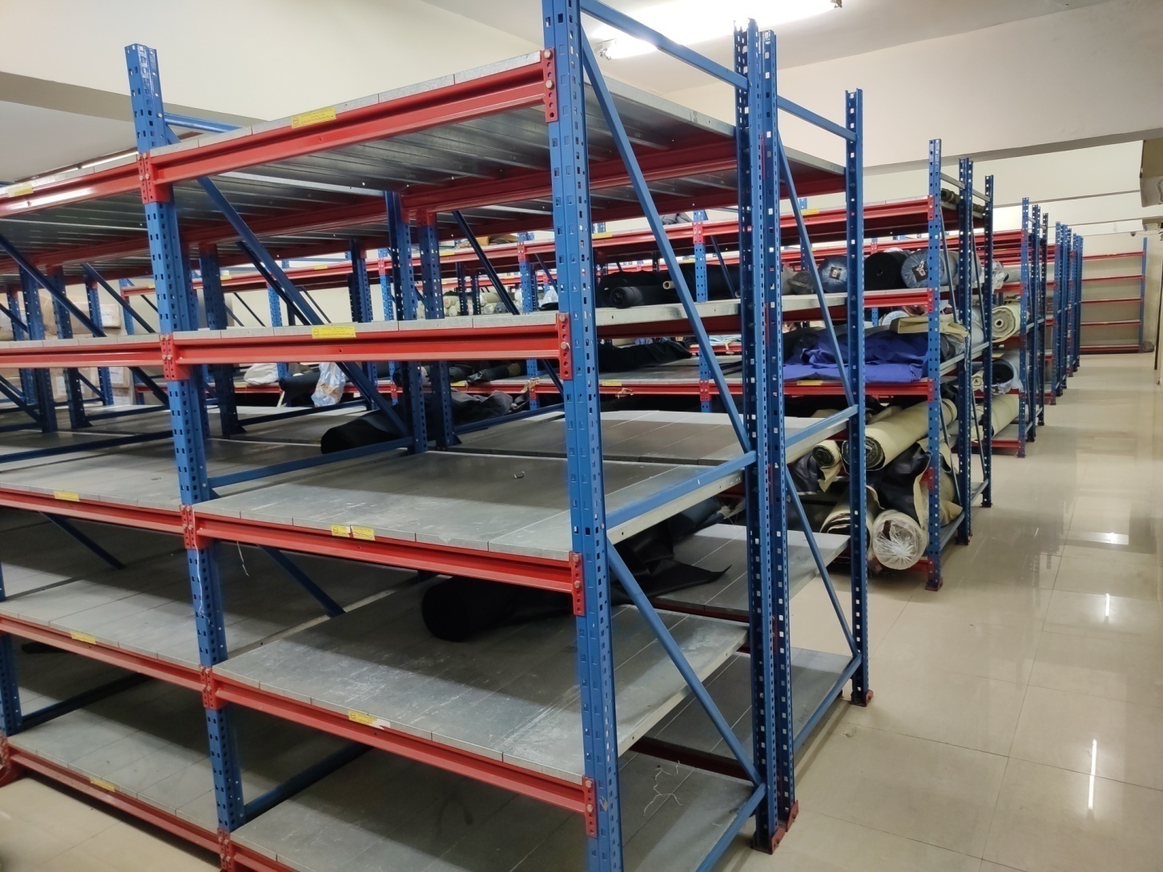
FABRIC STORE IN BASEMENT WITH STORAGE CAPACITY 40000 MTR.
IMAGE 1

Slide 9
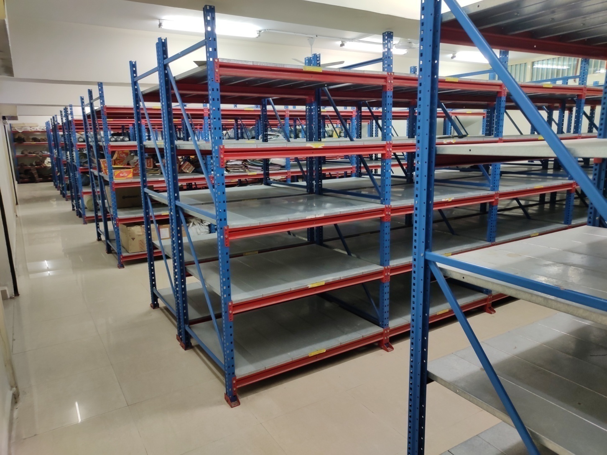
FABRIC STORE IN BASEMENT WITH STORAGE CAPACITY 40000 MTR.
IMAGE 2

Slide 10
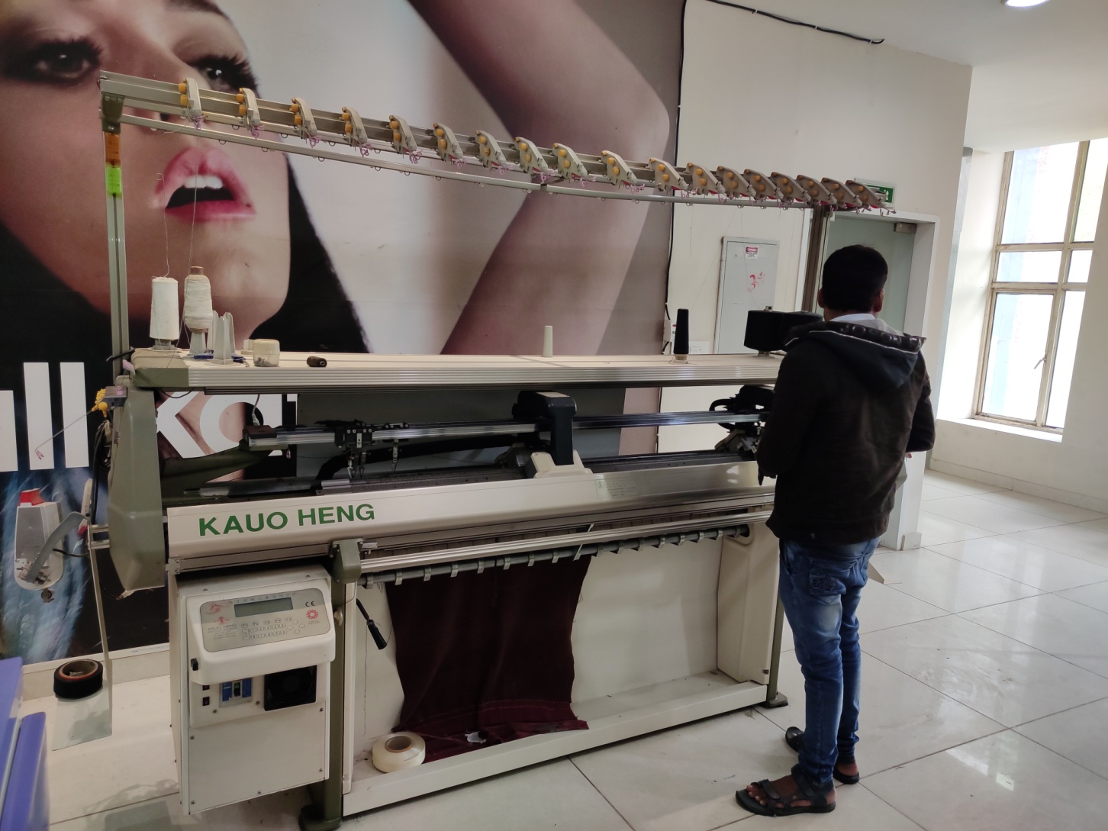
KNITTING DEPARTMENT IN HOUSE

Slide 11
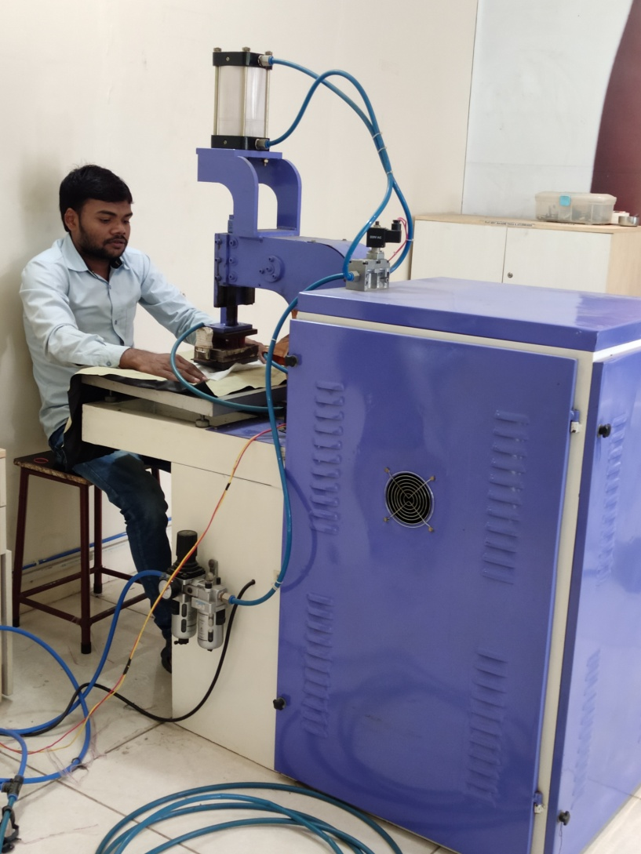
EMBOSSING DEPARTMENT(BRANDING ON P.U.)

Slide 12
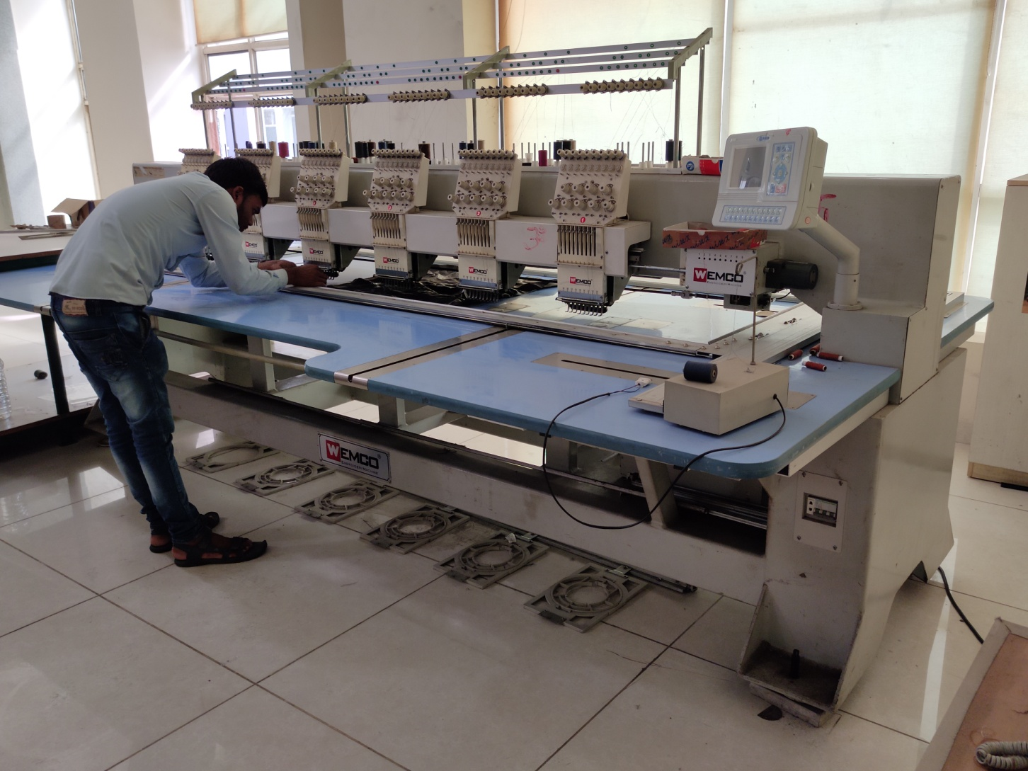
EMBROIDERY DEPARTMENT

Slide 13
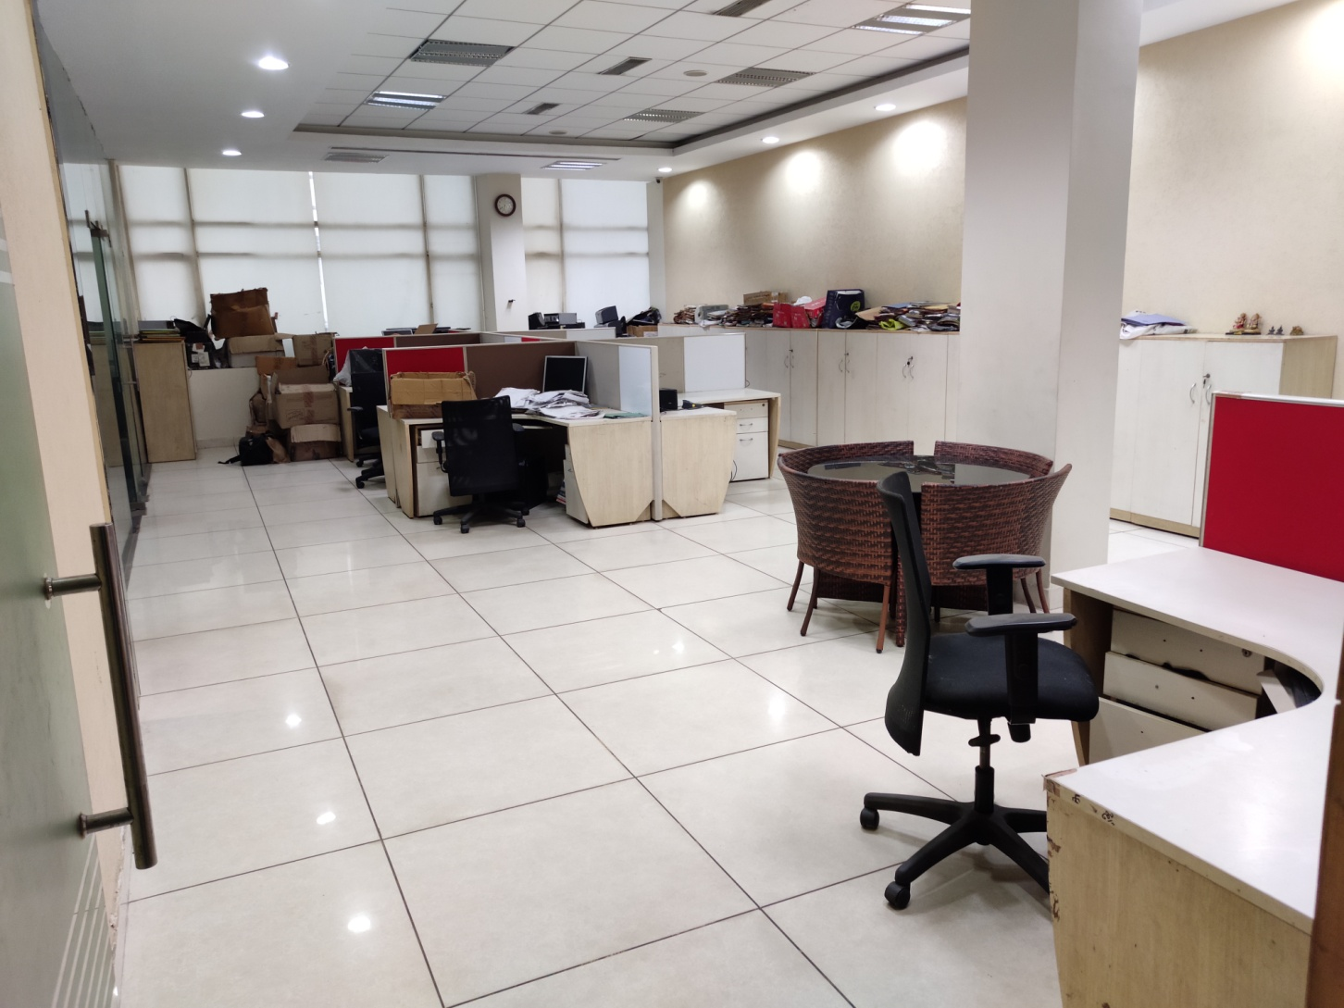
IT DEPARTMENT

Slide 14
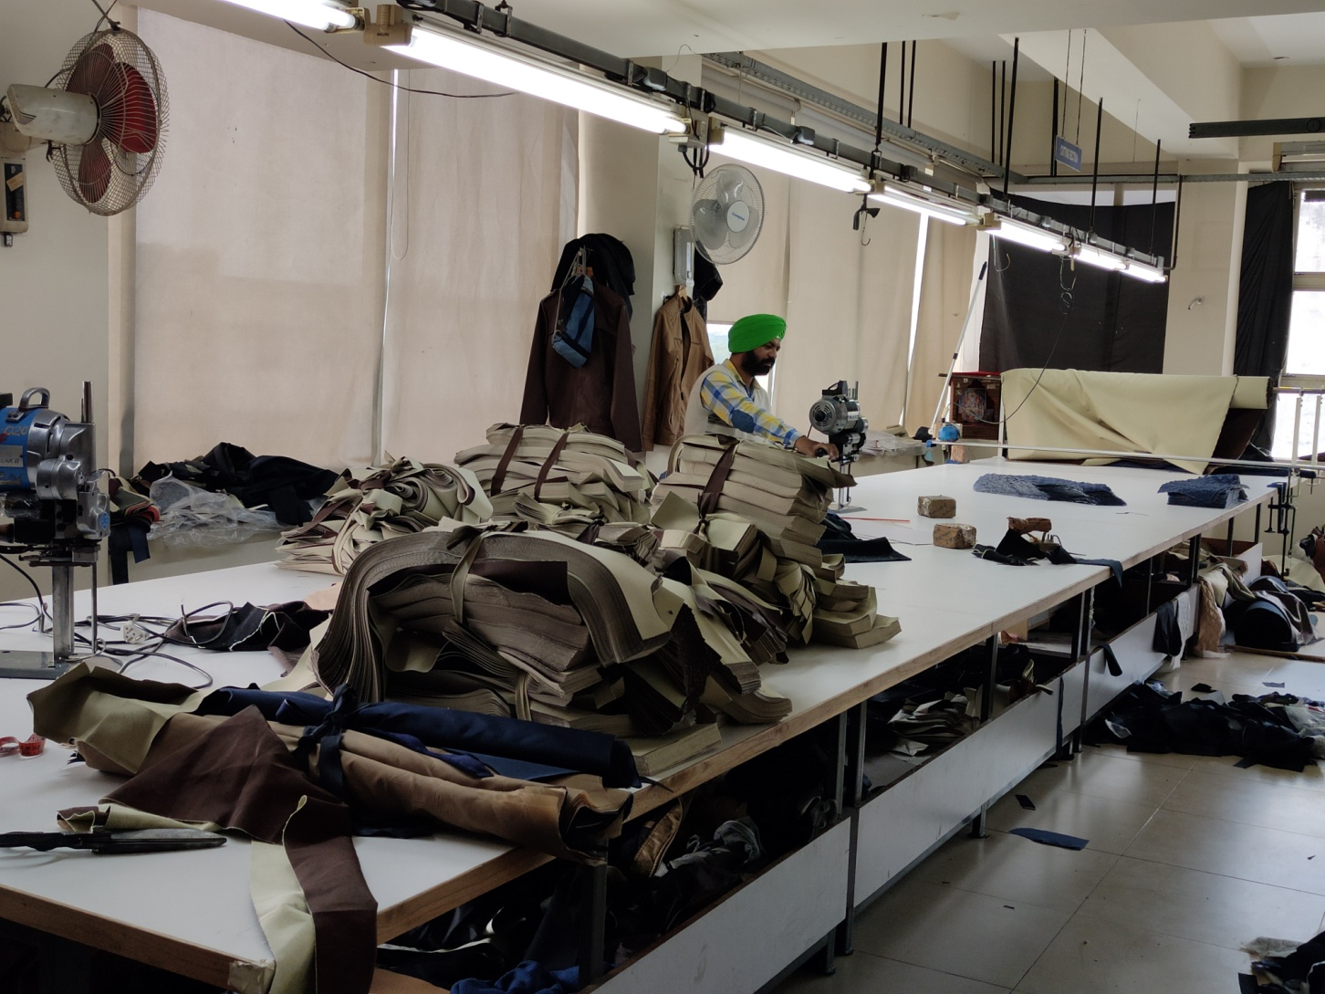
CUTTING UNIT 1 ON 2ND FLOOR

Slide 15
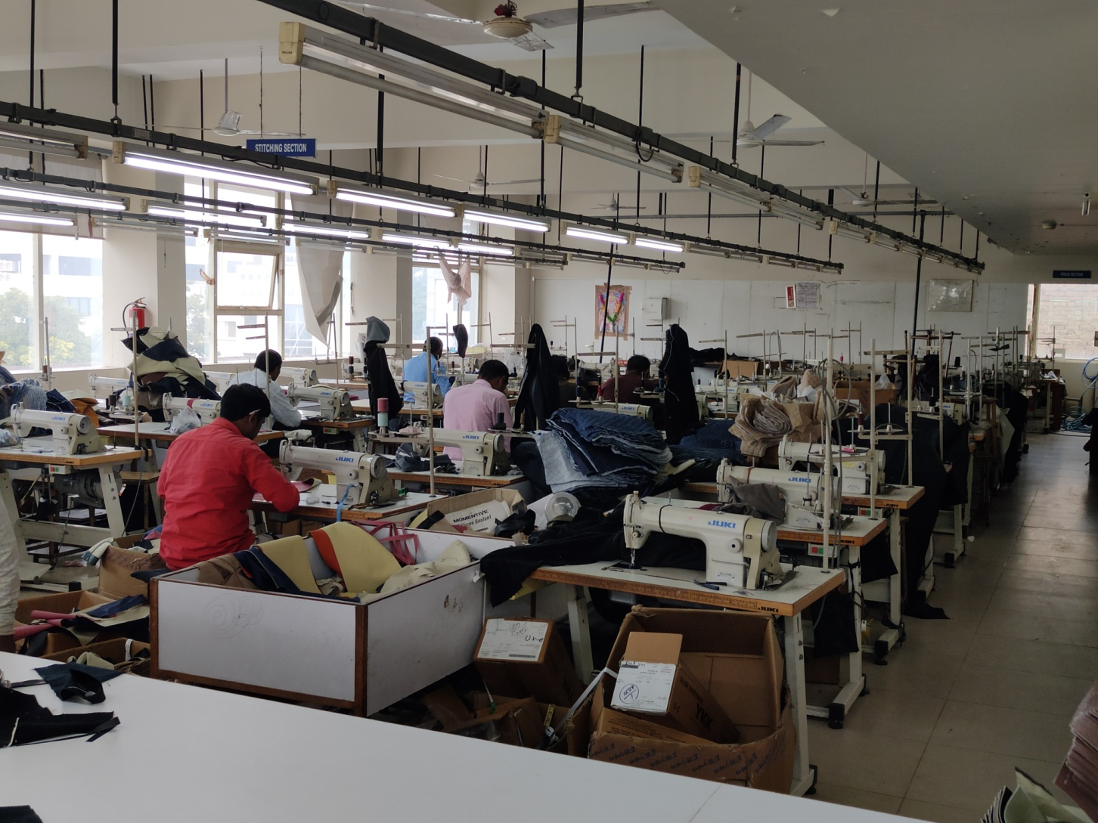
STITCHING UNIT 2ND FLOOR 60 SINGLE NEEDLE LOCKSTITCH MACHINES,
4 DOUBLE NEEDLE MACHINES

Slide 16
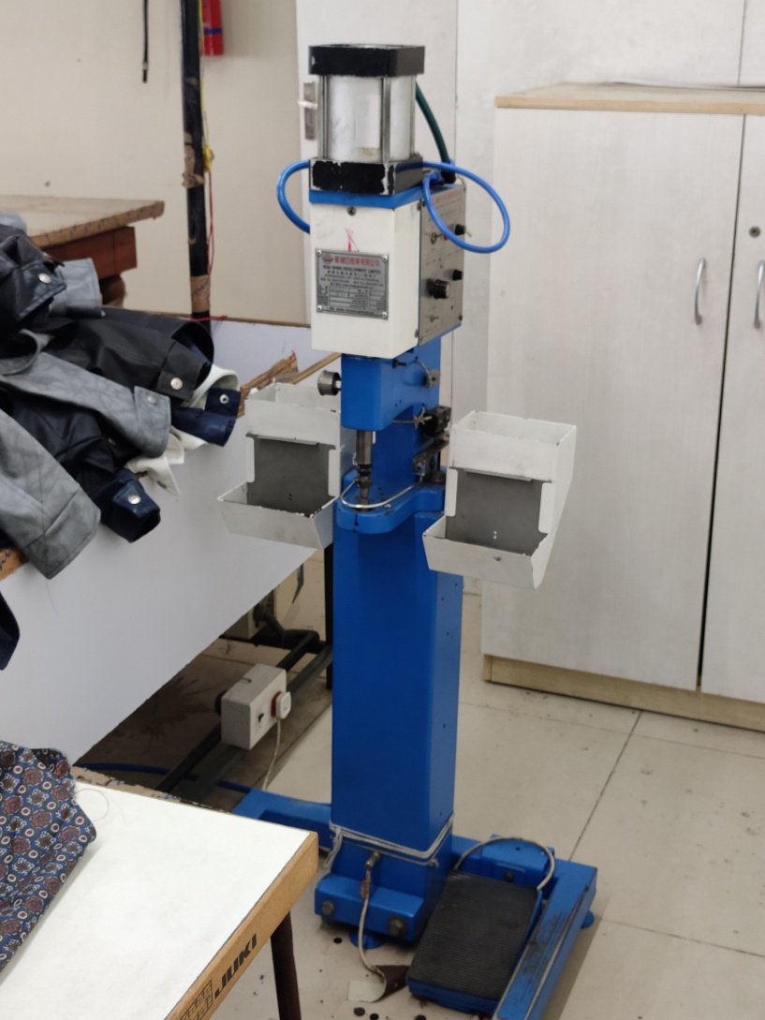
SNAP BUTTON HYROLIC AUTOMATIC

Slide 17
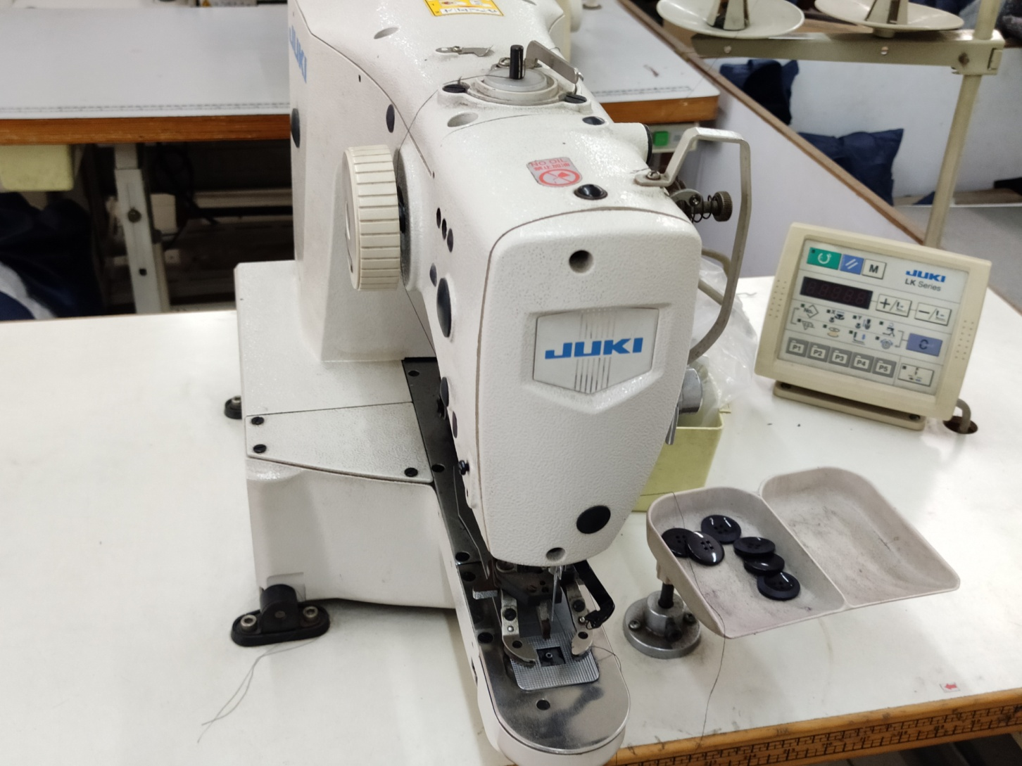
JUKI BUTTON COMPUTERISED LOCKSTITCH

Slide 18
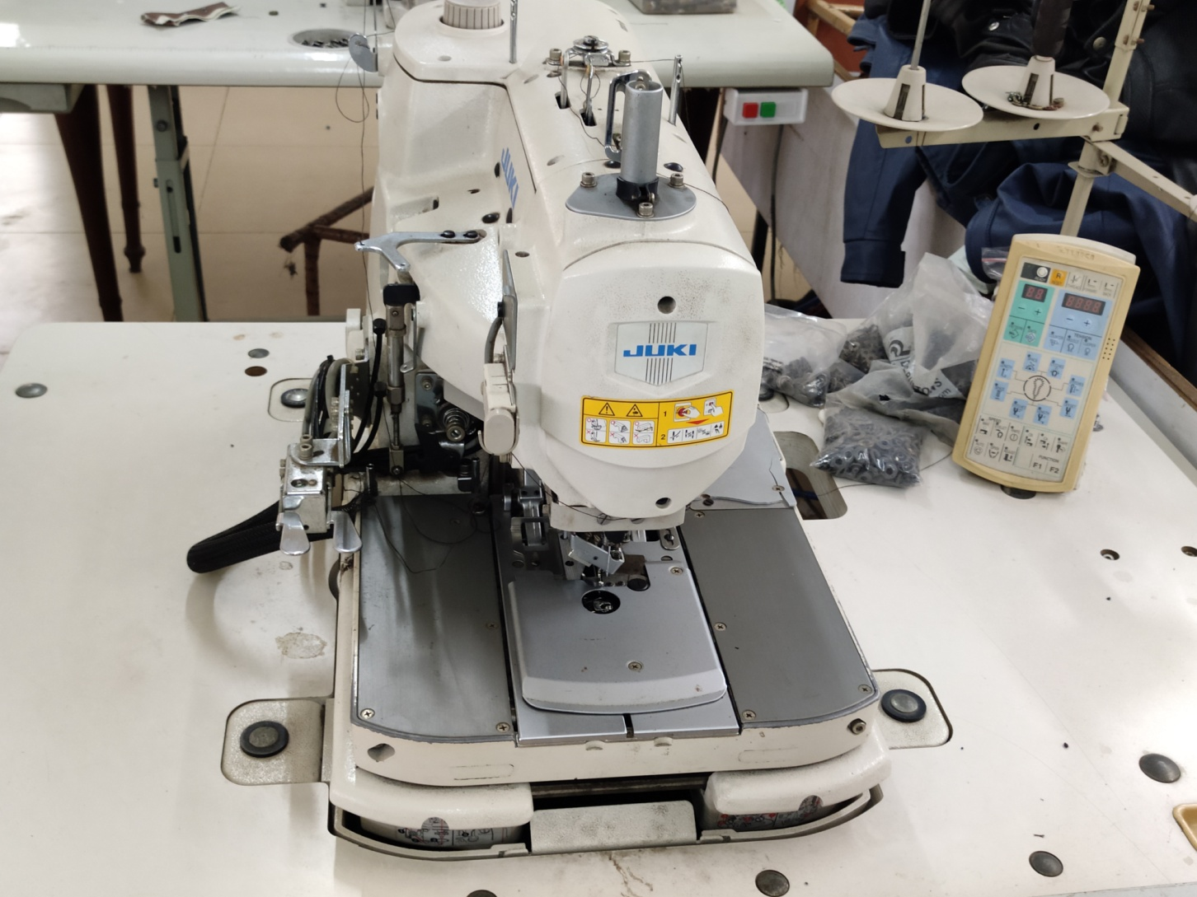
JUKI EYELET HOLE COMPUTERISED LOCKSTITCH

Slide 19
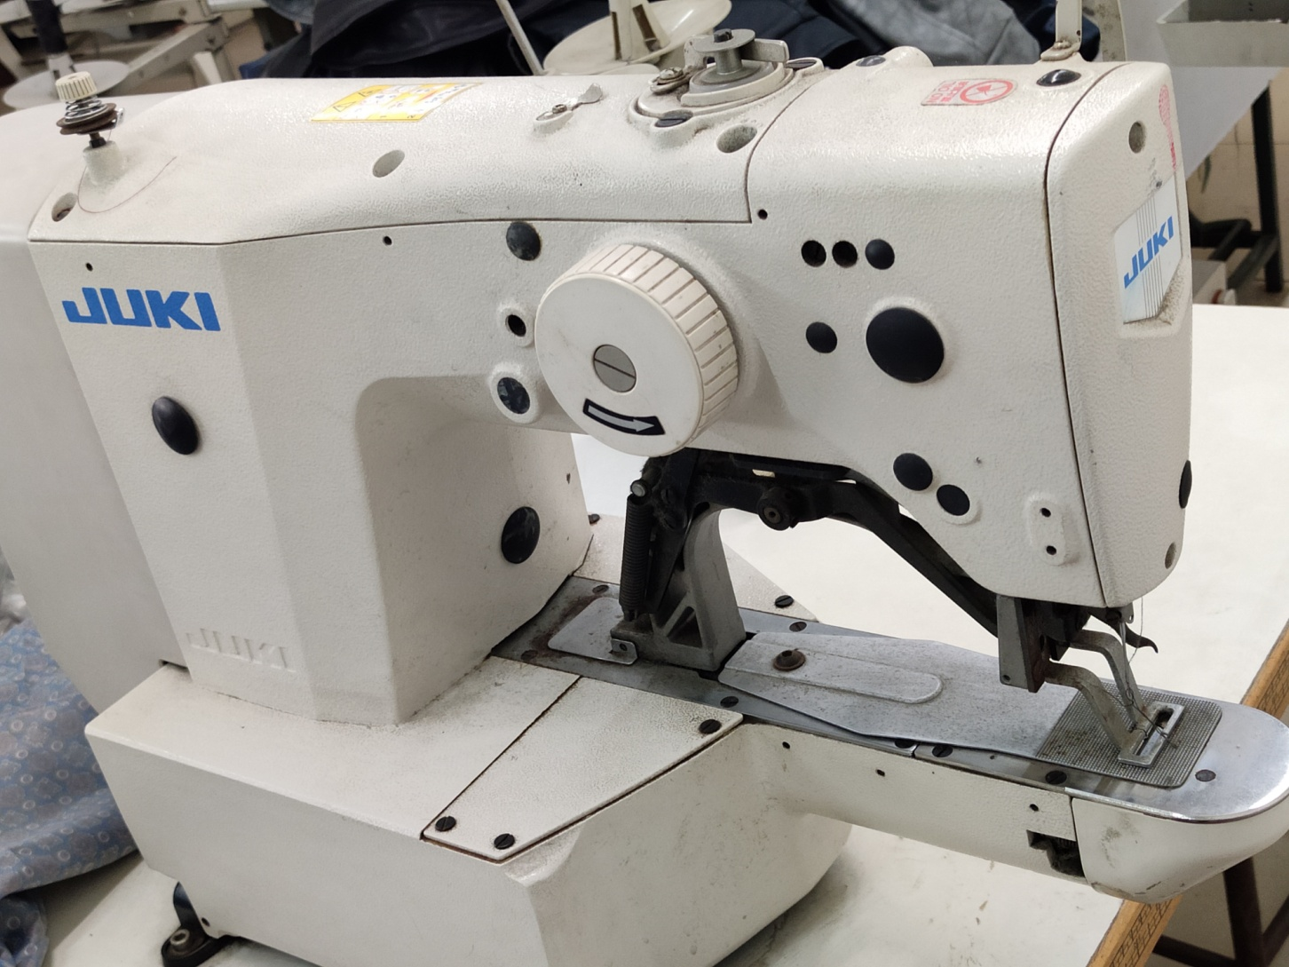
JUKI BARTACK COMPUTERISED LOCKSTITCH

Slide 20
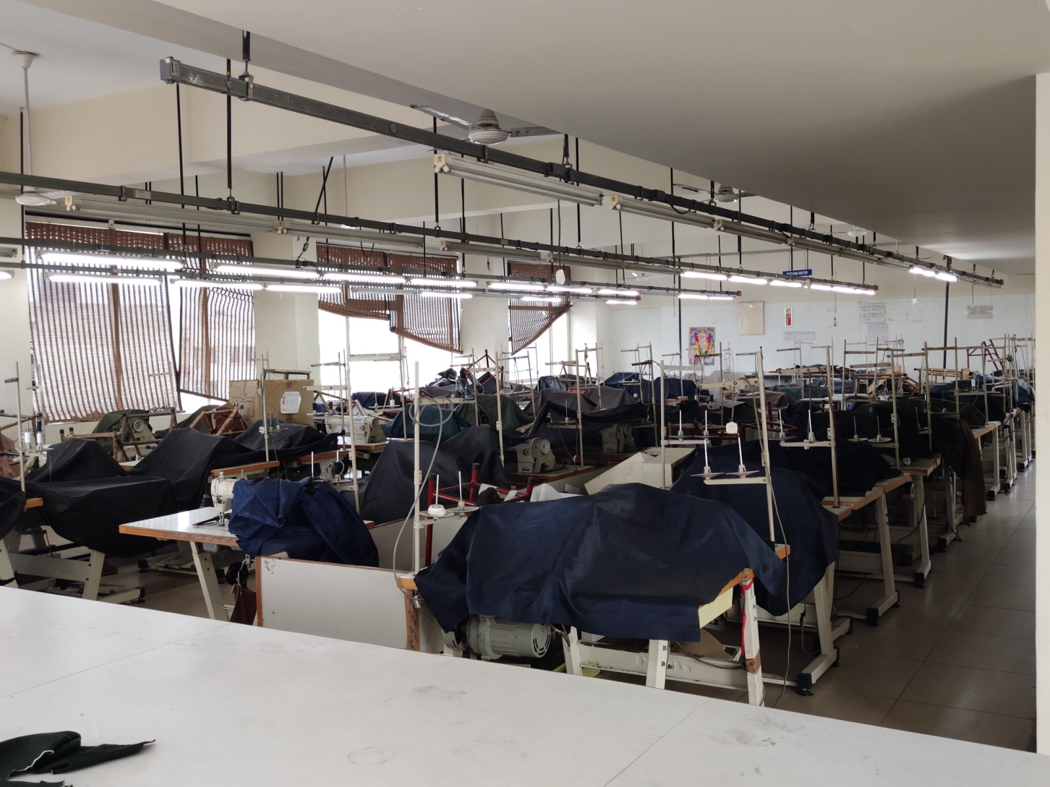
3RD FLOOR STITCHING BACK VIEW

Slide 21
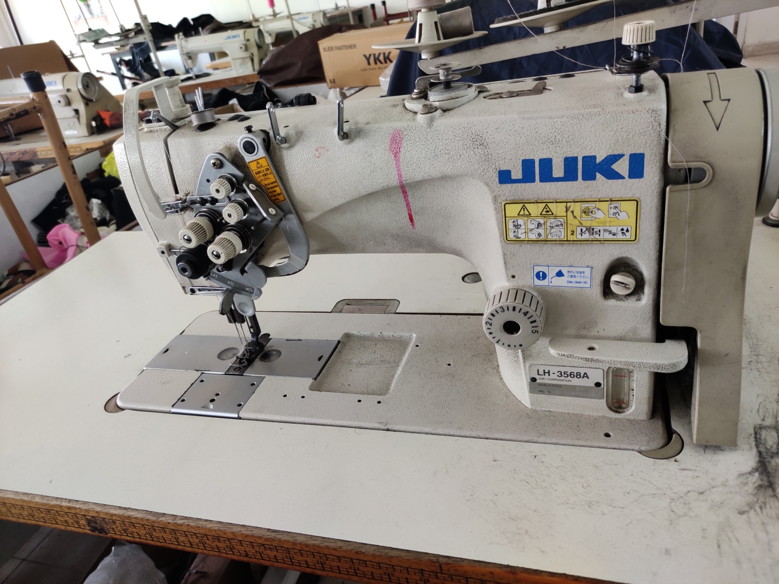
JUKI DOUBLE NEEDLE LOCKSTITCH (8 MACHINES)

Slide 22
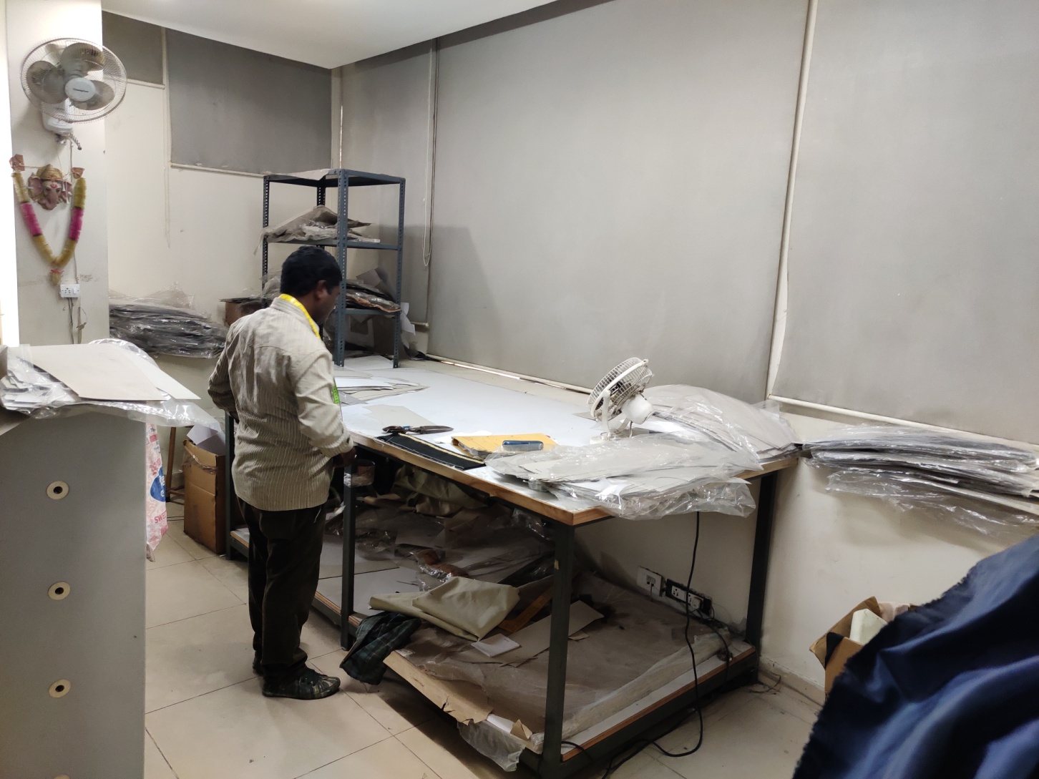
PATTERN DEPARTMENT

Slide 23
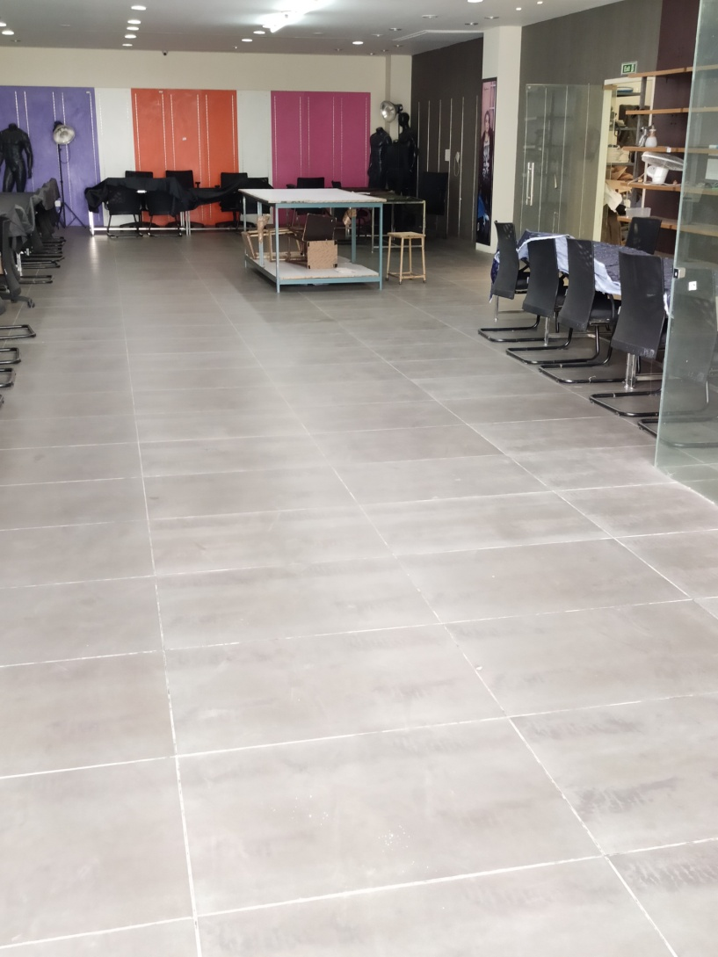
SEMI STITCH GOODS STORAGE -1ST FLOOR

Slide 24
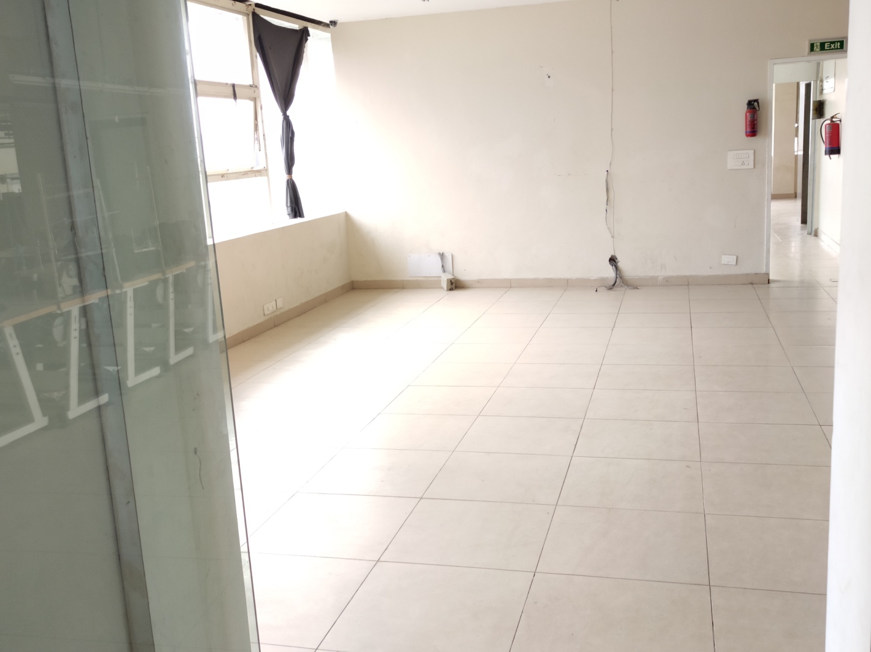
SEMISTITCHED GOODS STORAGE 3RD FLOOR

Slide 25
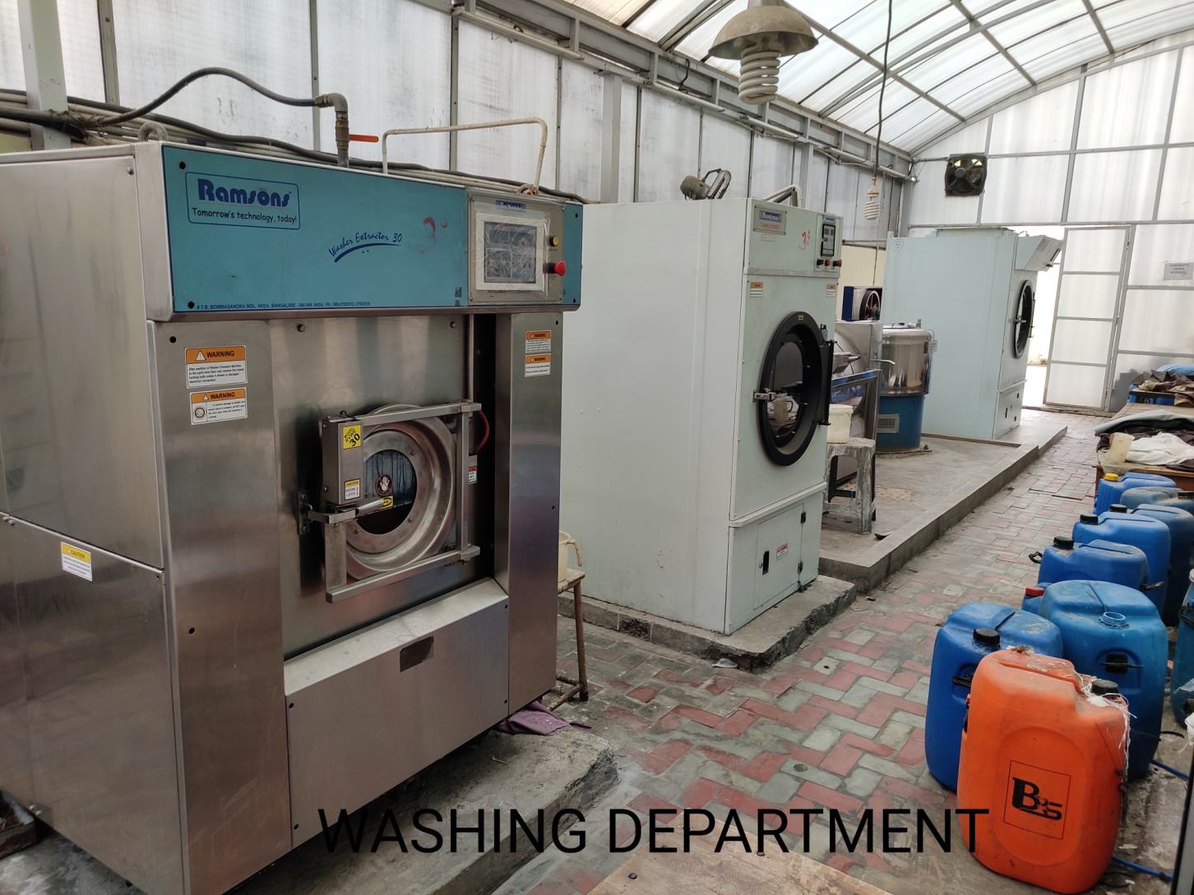
WASHING DEPARTMENT IMAGE 1

Slide 26
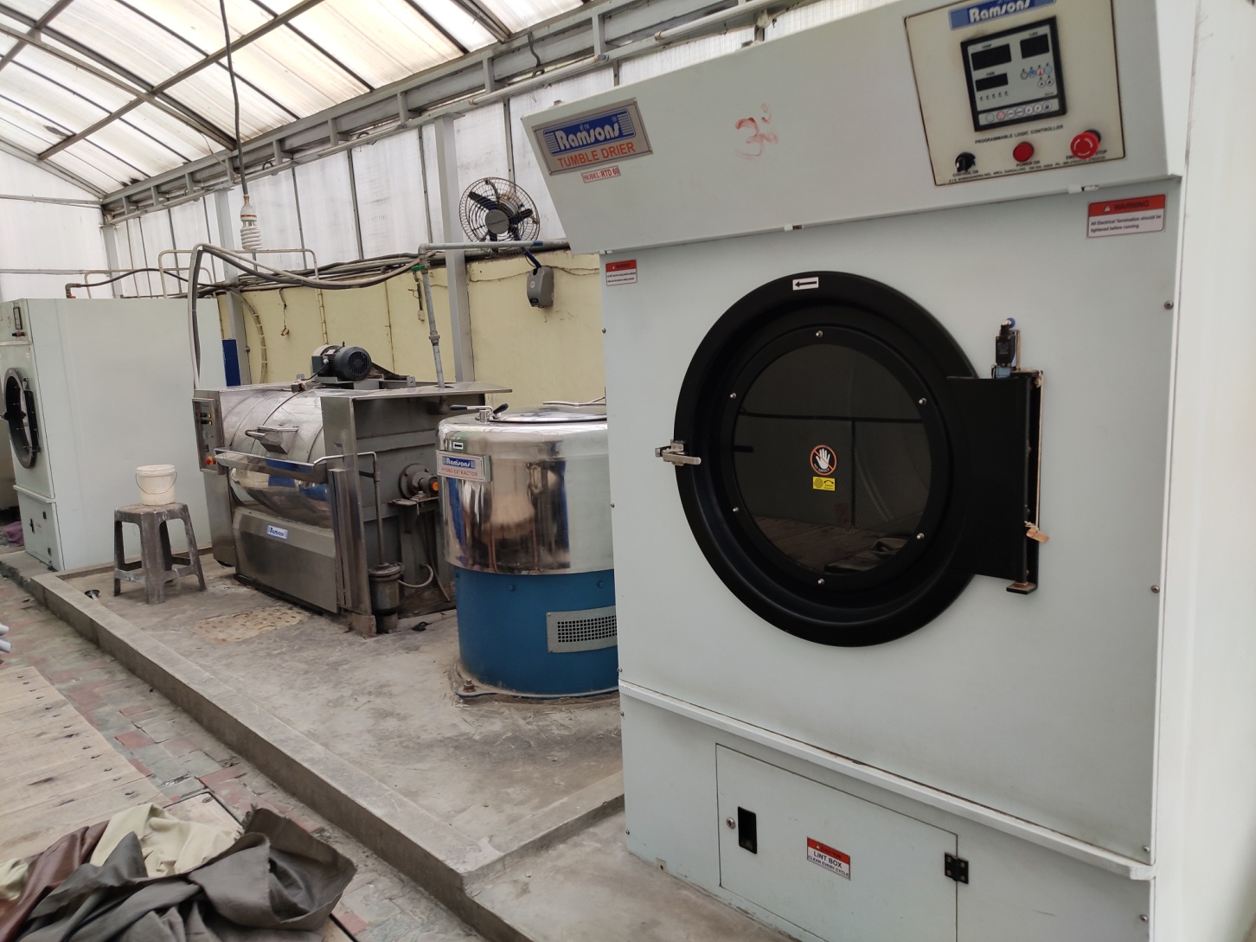
WASHING DEPARTMENT IMAGE 2

Slide 27
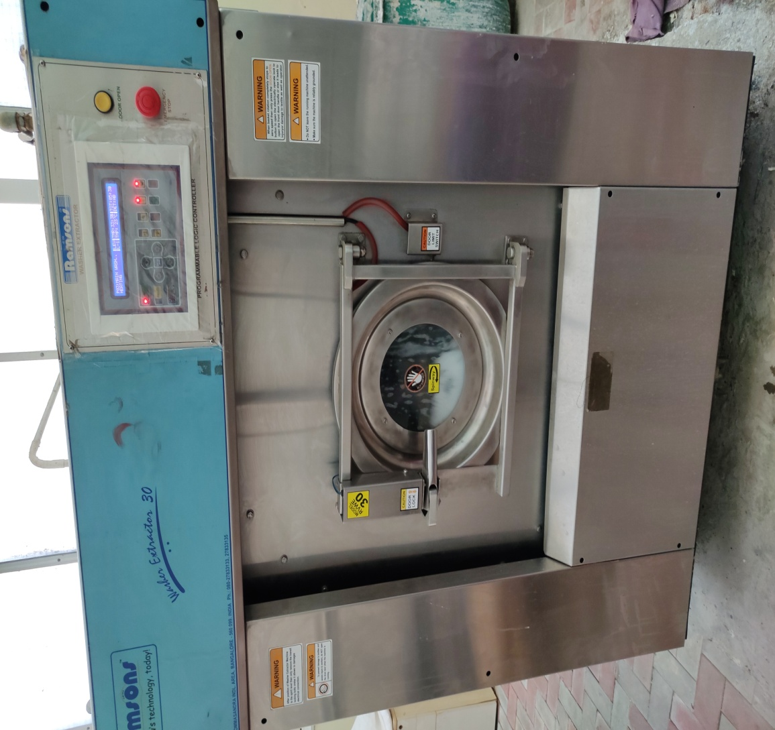
FRONT LOADING AUTOMATIC WASHING MACHINE (RAMSONS)
CAPACITY 30KG

Slide 28
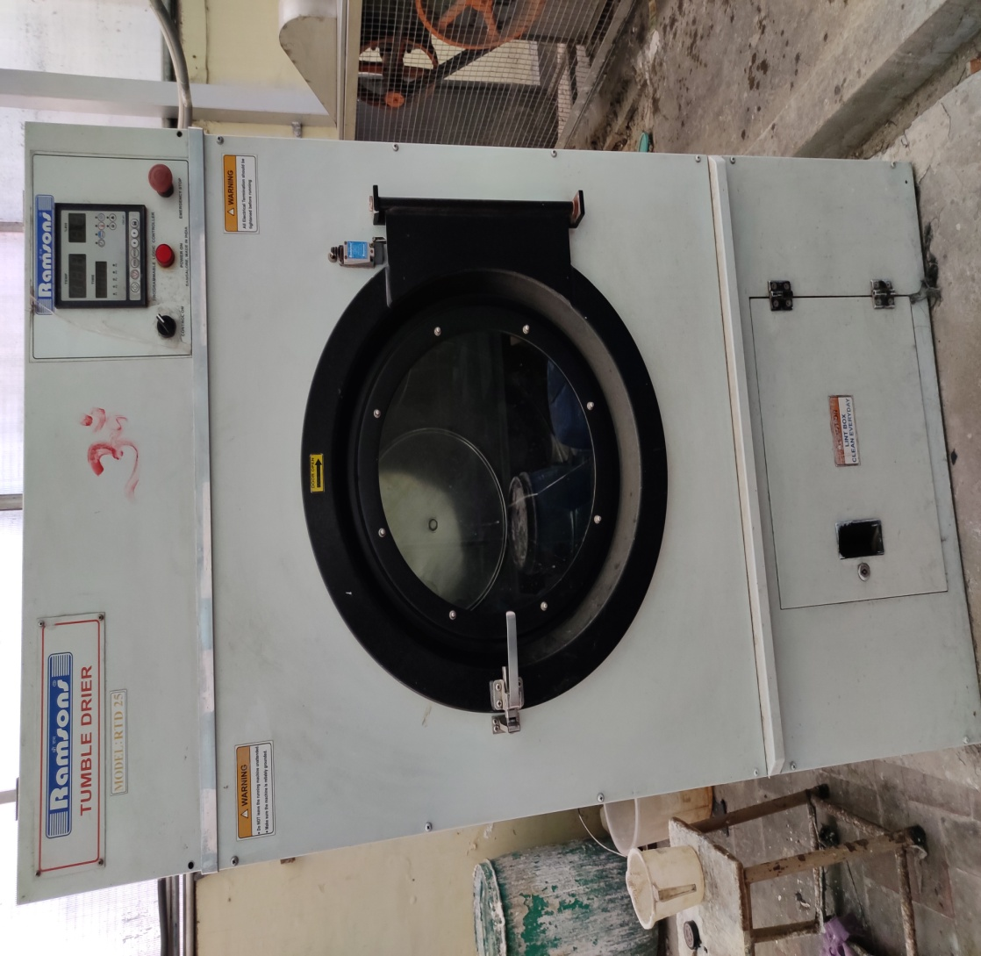
TUMBLE DRIER CAPCITY 30 KG

Slide 29
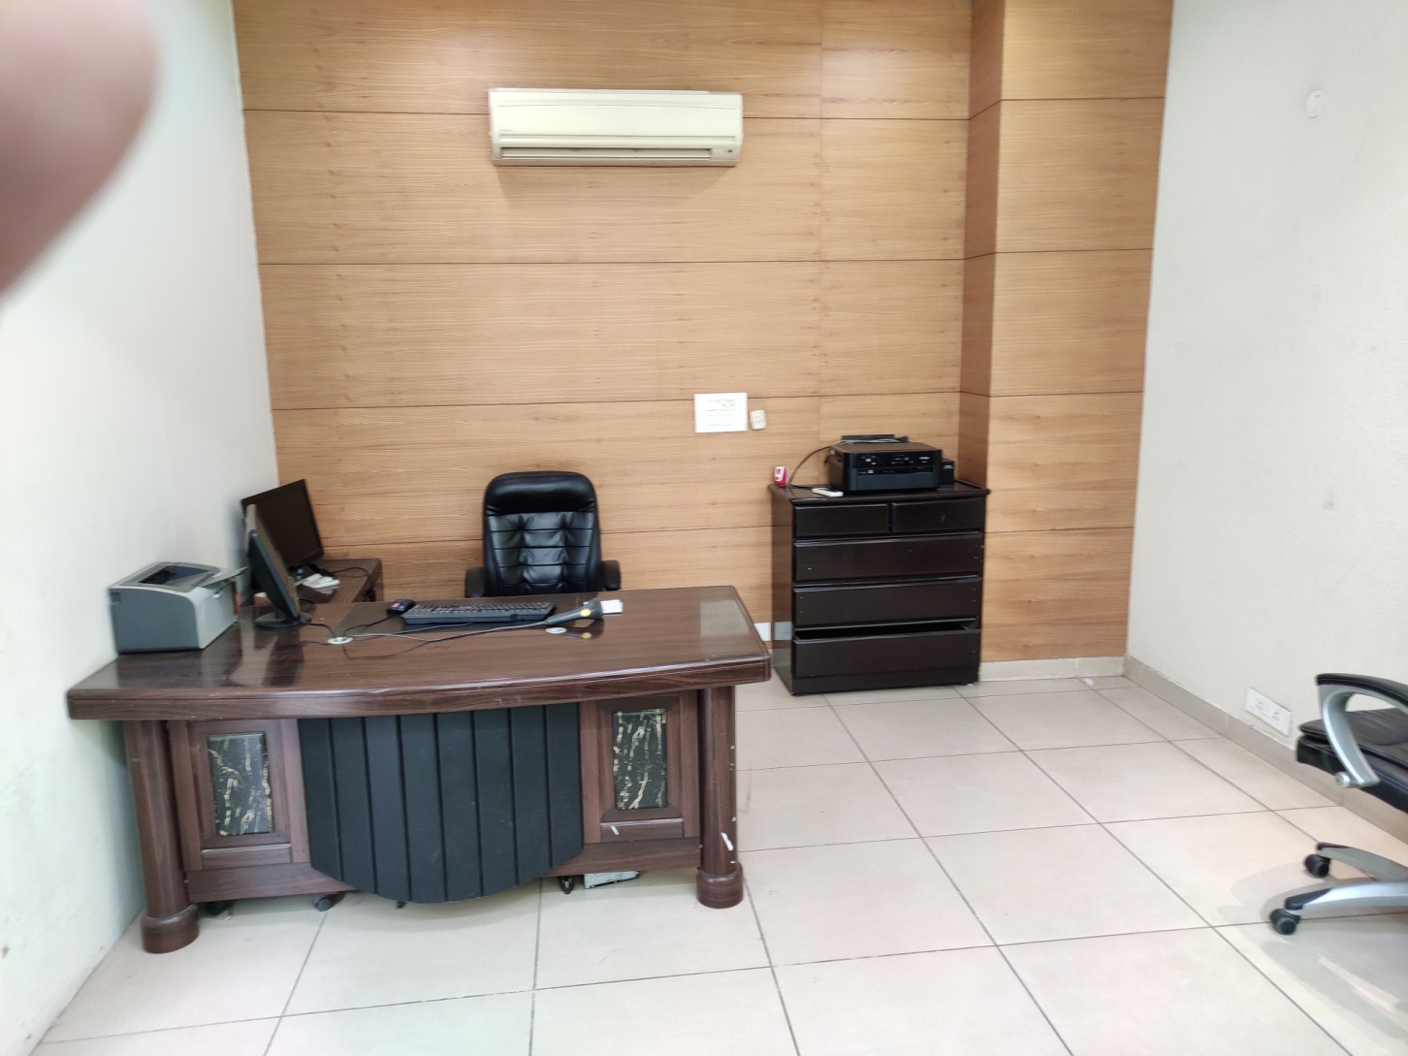
GOODS SCANNING DEPARTMENT

Slide 30
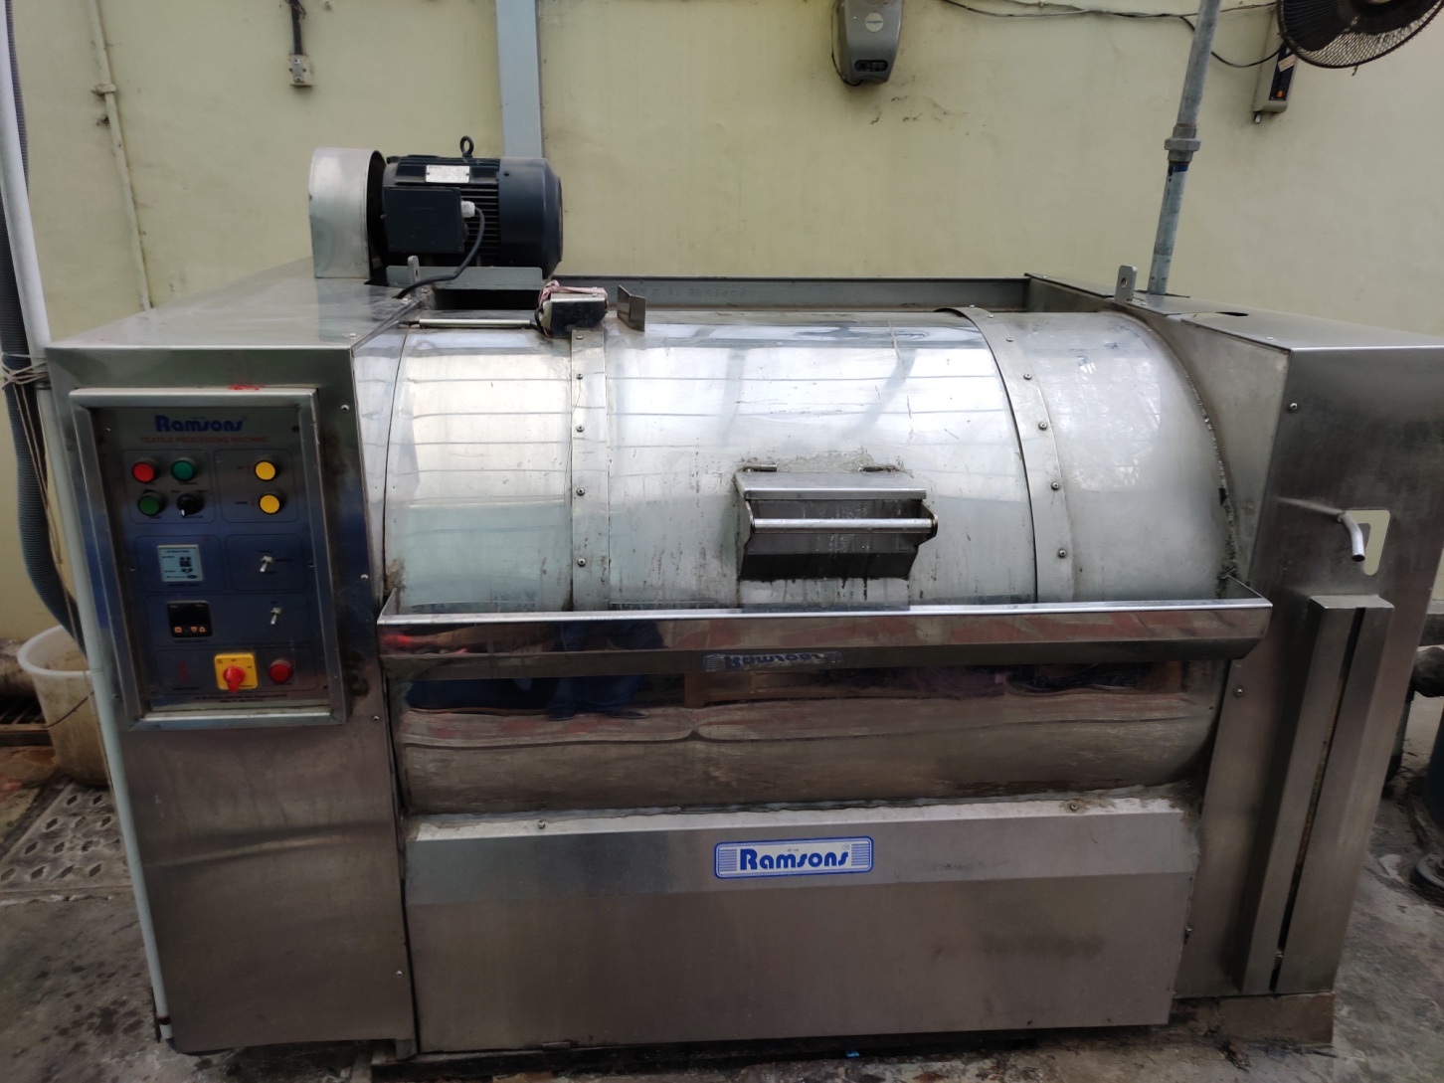
TOP LOADING WASHING MACHINE CAPACITY 65 KG

Slide 31
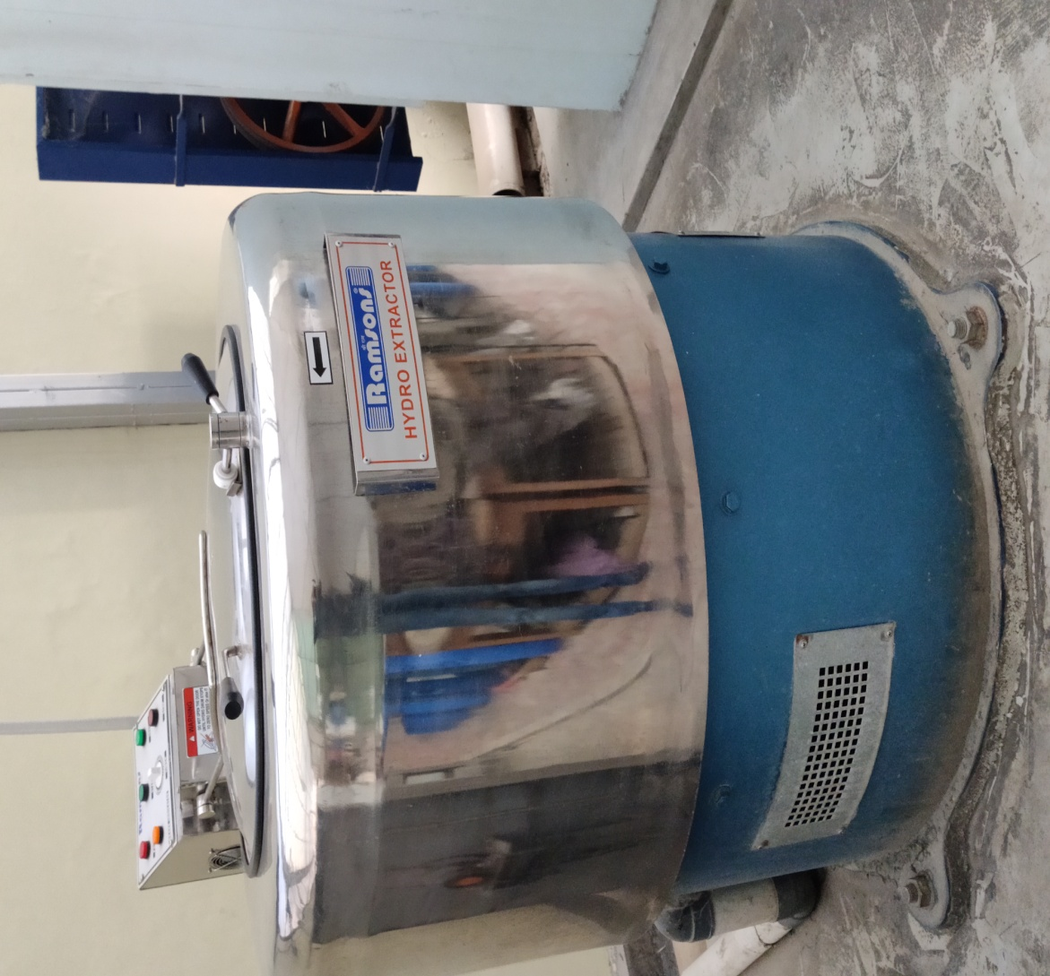
HYDRO EXTRACTOR CAPACITY 60 KG

Slide 32
2ND TUMBLER DRIER CAPACITY 60KG

Slide 34
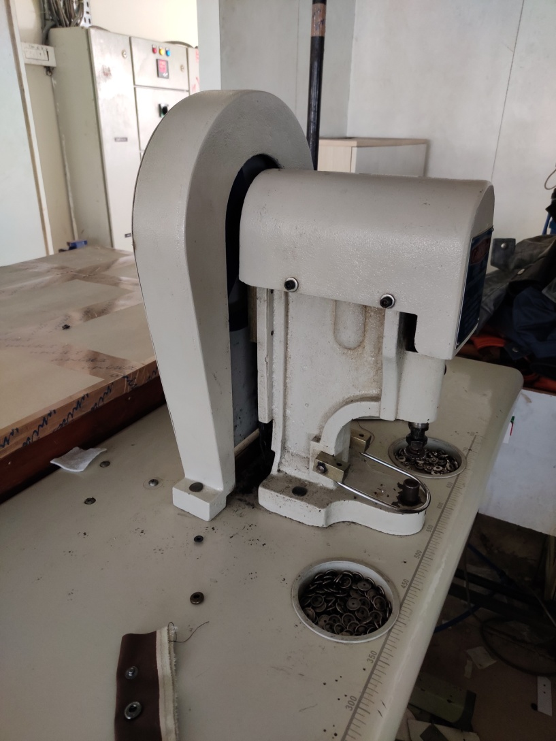
MANUAL SNAP BUTTON

Slide 35
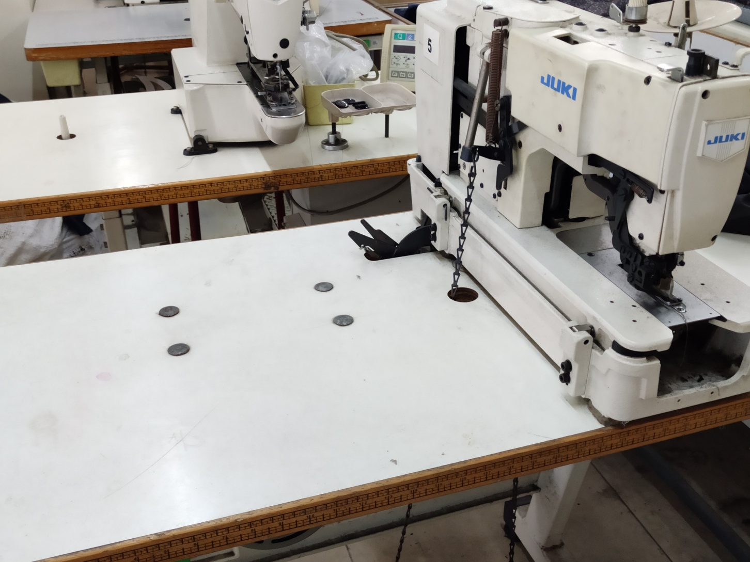
JUKI KAAJ MANUAL LOCKSTITCH

Slide 36
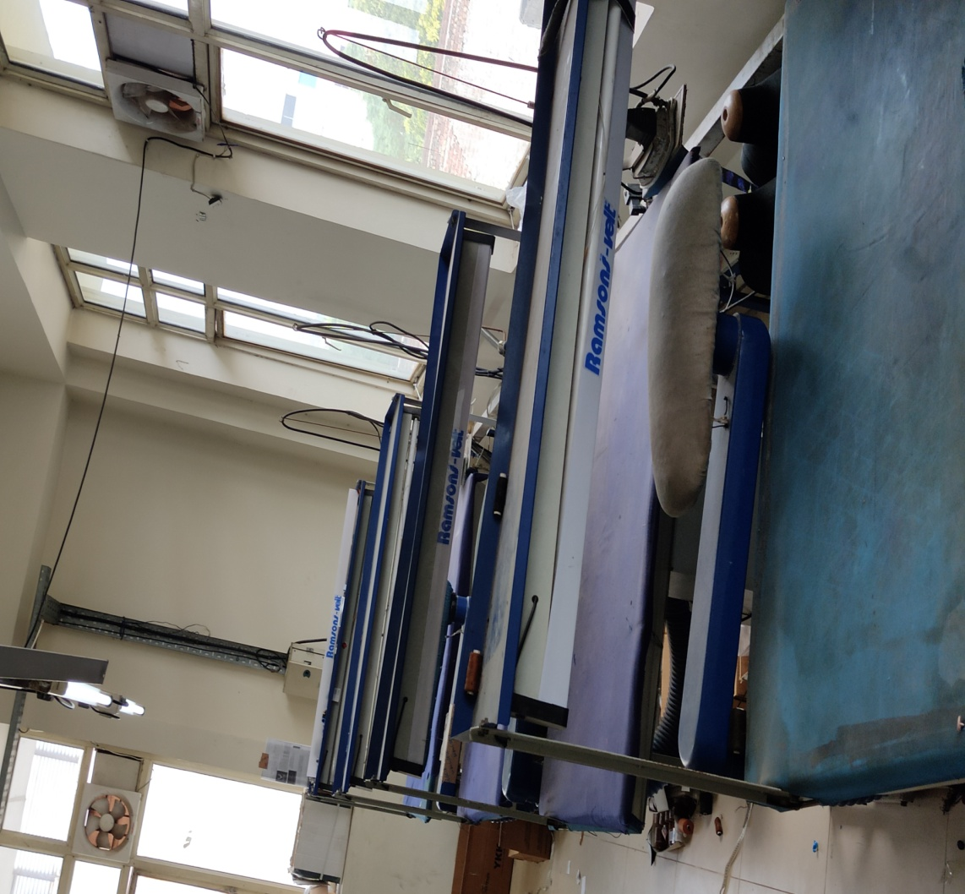
PRESSING DEPARTMENT 2ND FLOOR

Slide 37
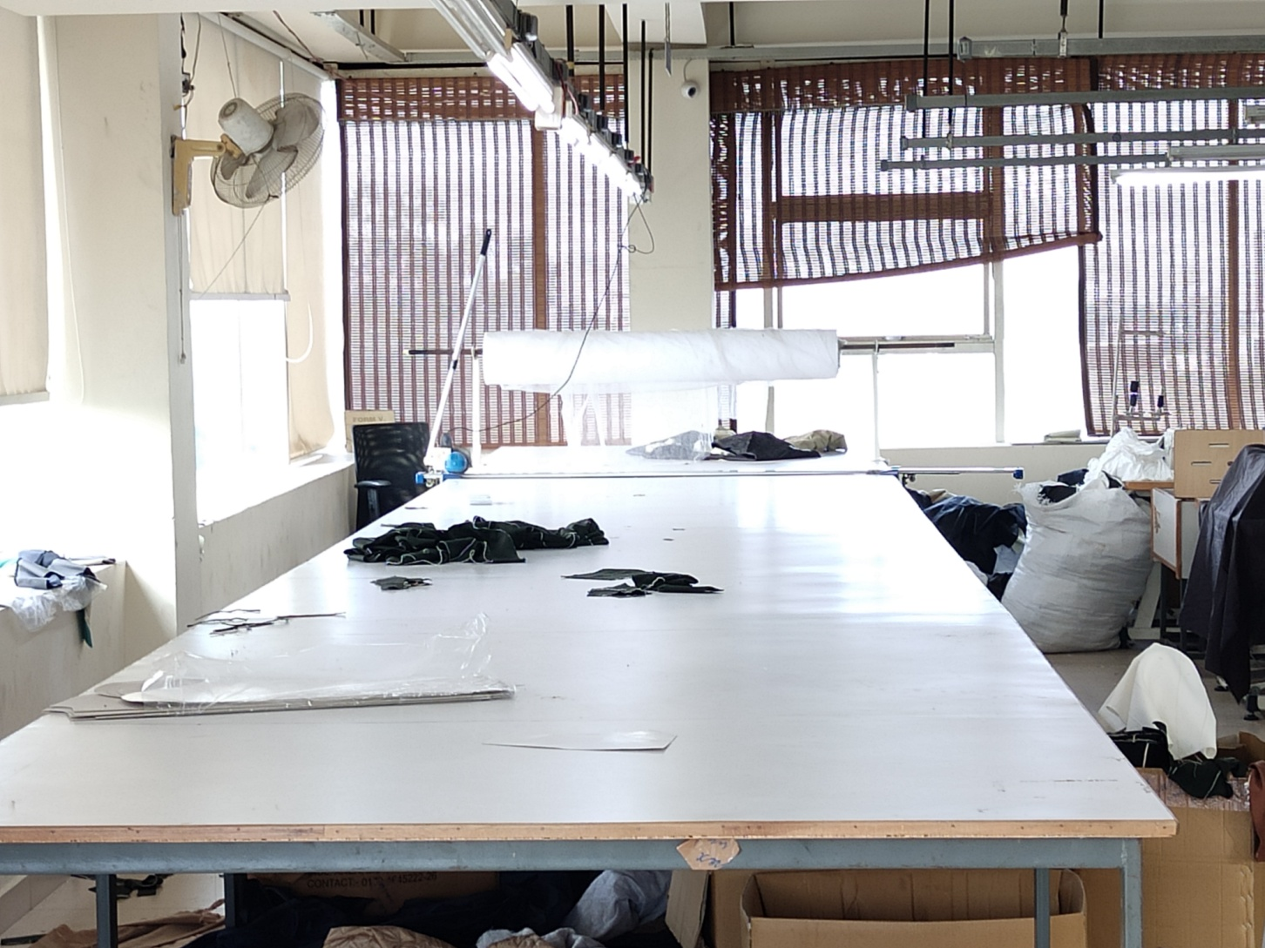
3^{RD FLOOR} CUTTING UNIT 2

Slide 38
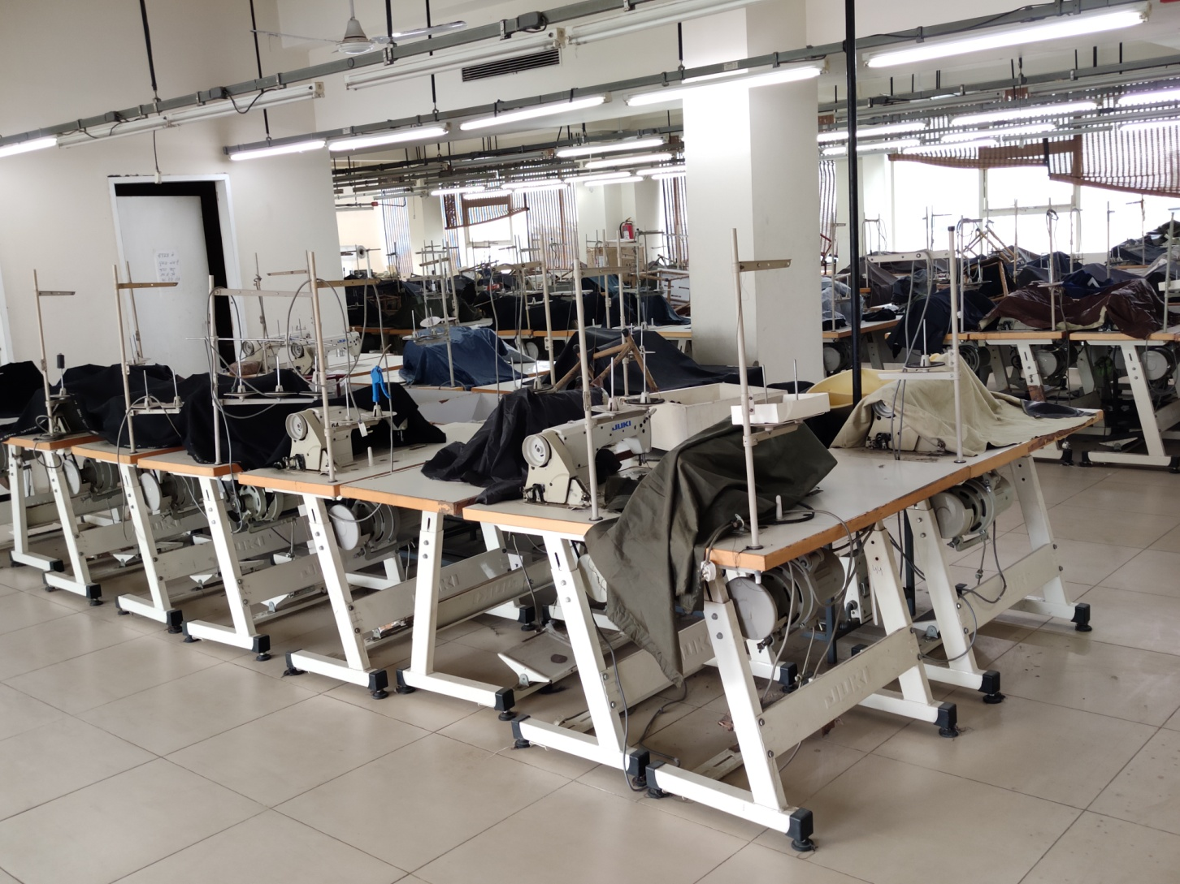
3RD FLOOR STITCHING DEPARTMENT SINGLE NEEDLE LOCKSTITCH -60 MACHINES, DOUBLE NEEDLE LOCKSTITCH-4 MACHINES

